Slide 1

CSE299 · SECTION 10 · TEAM NEXUS
Sprint 3 Weekly Project Review
A Full Front-End Product, Live and Running
SPRINT SNAPSHOT
Window: July 21 – Aug 3, 2026 | Status: Completed · 100% | Priority: Medium | Duration: 2 weeks
Jihanur Rahman Ratul - 2412800642
Team Lead — Frontend, Repository & DevOps
Tahsin Ahmed Sufol
Backend Review & Integration Planning
Prepared for ITN Sir · CareerSetu — NSU Alumni-Industry Bridge Platform

Slide 2
PROJECT OVERVIEW
CareerSetu, at a Glance
Three sprints in, CareerSetu now has a real, running product: a 10-page Next.js frontend covering every pillar from the proposal.
AI CV grooming, a verified job board, blockchain-verified credentials, and the Career Magazine are all live on localhost — not mockups, working screens.
This report covers Sprint 3 (July 21 – Aug 3) and previews Sprint 4, now underway.
SPRINT-BY-SPRINT STATUS
Sprint 1
100%
Completed
Jul 6 – 13
Data collection: NSU alumni & company datasets
Sprint 2
100%
Completed
Jul 13 – 21
Repository, branching strategy & CI/CD pipeline
Sprint 3
100%
Completed
Jul 21 – Aug 3
10-page Next.js frontend, fully designed & built
Sprint 4
30%
In Progress
Aug 4 – 10
Backend, database & AI/ML microservice integration
CareerSetu | Sprint 3 Weekly Review | CSE299 Sec.10
02 / 17

Slide 3
SPRINT 3 · JULY 21 – AUG 3, 2026
Sprint Goal & Key Deliverables
SPRINT OBJECTIVE
Writing the front-end code for the Alumni platform — a complete, feature-rich Next.js experience covering every component defined in the project proposal.
KEY DELIVERABLES
A full TypeScript type system plus realistic NSU convocation & employer mock datasets
A consistent dark glassmorphism design system carried across every page
AI Trust Badge, Blockchain Verification, and Payment/Monetization components
10 feature-complete pages: Home, CV Grooming, Alumni Directory, Jobs, Employer Portal, Magazine, Admin, Insights, Dashboard, Profile
SPRINT META
Completed · 100%
Medium Priority
Tag: Design
Tag: Frontend
Tag: Docs
Duration
2 weeks — extended from the original 1-week plan
Owner
Jihanur Rahman Ratul (lead), reviewed with Tahsin Ahmed Sufol
CareerSetu | Sprint 3 Weekly Review | CSE299 Sec.10
03 / 17

Slide 4





WEEKLY PROGRESS
How the Sprint Unfolded
Jul 26
Tahsin acknowledges the Sprint 2 → 3 handoff plan in Slack — frontend build begins.
Aug 2
Jihan checks progress on the frontend and backend, and asks Tahsin to review main and open a PR — the CI/CD pipeline merges automatically once checks pass.
HOW WE TRACK PROGRESS
Slack (#299) still handles day-to-day coordination. The Notion Sprint Tracker remains the source of truth for objectives, deliverables, completion % and retrospectives — reported here each week.
Aug 2
Tahsin confirms he’s reviewing and will follow the new PR workflow.
Today
Jihan reports the frontend is essentially done; the conversation shifts to backend status, DB, and wiring the ML/AI microservices in — Sprint 4 begins early.
CareerSetu | Sprint 3 Weekly Review | CSE299 Sec.10
04 / 17

Slide 5
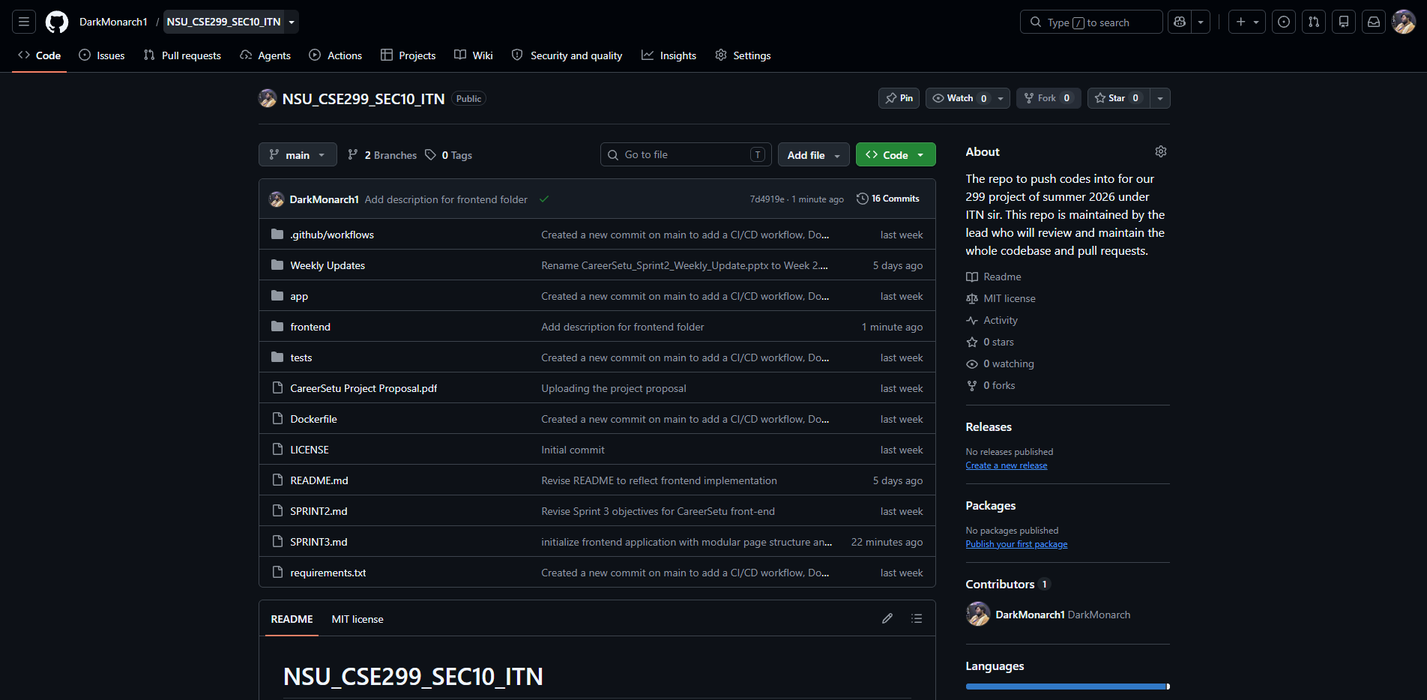
EVIDENCE · 1 OF 4
Repository & Commit History
16 commits on main so far, all authored by the lead (DarkMonarch1)
Latest commits: "initialize frontend application with modular page structure and core authentication context" and "Frontend setup with Next.js and other necessary configurations"
A new frontend/ folder joins the existing app/, tests/ and CI/CD structure from Sprint 2
Repo governance is unchanged: the lead reviews and merges every pull request
github.com/DarkMonarch1/NSU_CSE299_SEC10_ITN
CareerSetu | Sprint 3 Weekly Review | CSE299 Sec.10
05 / 17

Slide 6
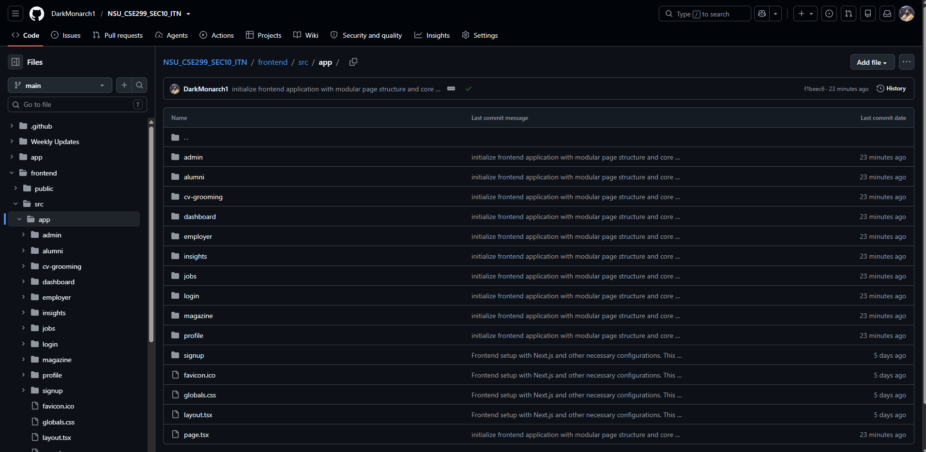
EVIDENCE · 2 OF 4
10 Pages, One Router
Built on the Next.js App Router — every route lives under frontend/src/app/
10 top-level pages: admin, alumni, cv-grooming, dashboard, employer, insights, jobs, login, magazine, profile, signup
A shared layout.tsx and globals.css keep navigation and styling consistent across all of them
Every page maps directly to a component named in the original project proposal
NSU_CSE299_SEC10_ITN/frontend/src/app
CareerSetu | Sprint 3 Weekly Review | CSE299 Sec.10
06 / 17

Slide 7
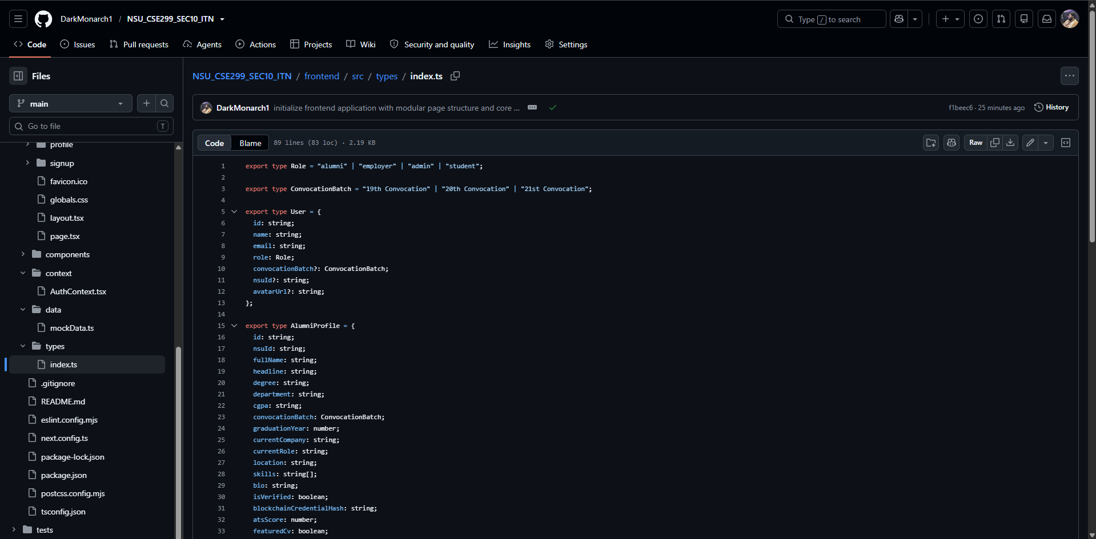
EVIDENCE · 3 OF 4
Under the Hood: Types, Data & Trust Components
types/index.ts defines schemas for Role, ConvocationBatch, AlumniProfile, JobPosting, CVGroomingReport, Employer and MagazineArticle
Realistic mock data spans 19th–21st Convocation graduates and real Bangladeshi tech employers — Pathao, bKash, Brain Station 23, Therap, Samsung R&D
A shared Tailwind v4 dark glassmorphism design system (ambient gradients, badge pills) runs across every page
The AI Trust Badge, Blockchain Verification modal and Payment/Monetization checkout are built as reusable components, not one-off screens
frontend/src/types/index.ts
CareerSetu | Sprint 3 Weekly Review | CSE299 Sec.10
07 / 17

Slide 8
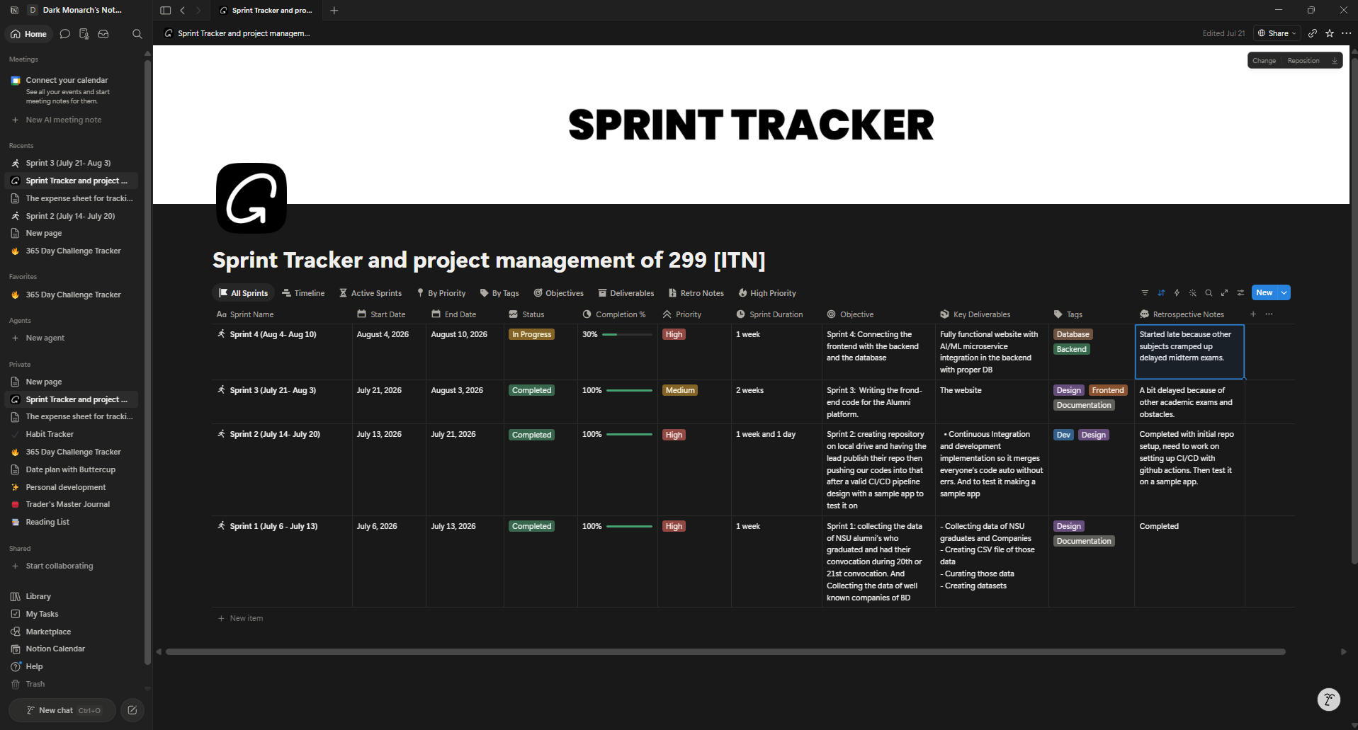
EVIDENCE · 4 OF 4
Sprint Tracking in Notion
Sprint 3 is logged Completed at 100%, medium priority, across a 2-week window (July 21 – Aug 3)
Retrospective notes stay honest: delayed a little by overlapping academic exams — the same caution flagged back in Sprint 2
Sprint 4 is already open in the same tracker — 30% in progress, focused on backend + database integration
One shared table remains the single source of truth for every weekly report
Notion — Sprint Tracker (299 [ITN])
CareerSetu | Sprint 3 Weekly Review | CSE299 Sec.10
08 / 17

Slide 9
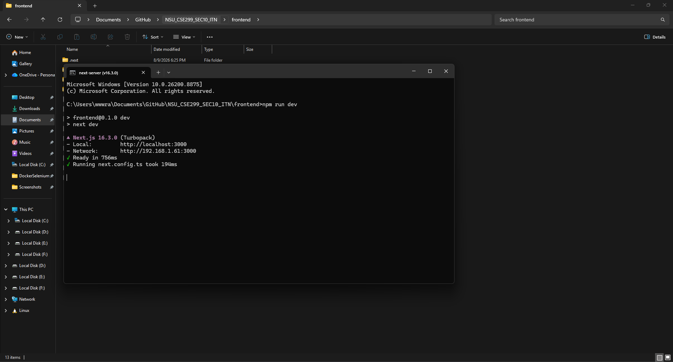
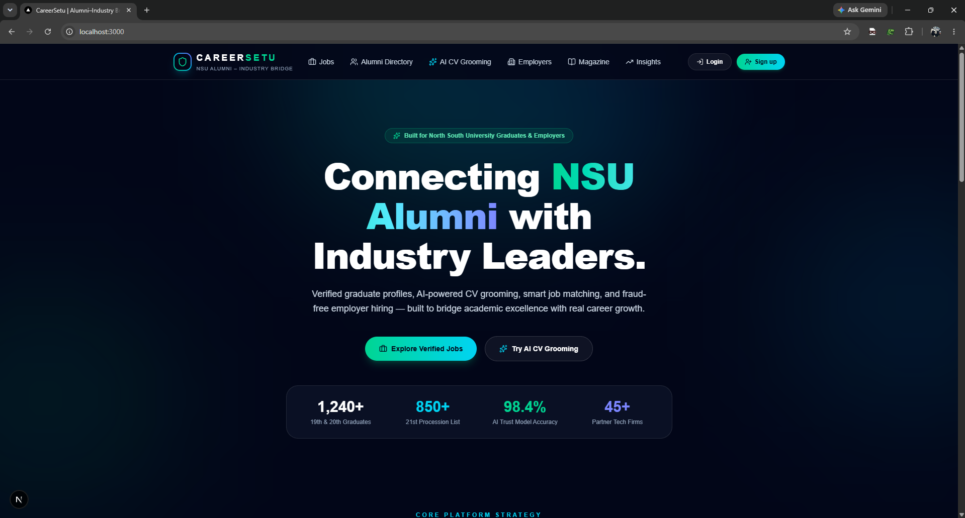
LIVE DEMO · 1 OF 4
It Runs Locally
npm run dev boots the whole platform in under a second — here’s what loads.
Terminal — Next.js 16.3.0 (Turbopack), ready in 756ms
localhost:3000 — CareerSetu homepage
CareerSetu | Sprint 3 Weekly Review | CSE299 Sec.10
09 / 17

Slide 10
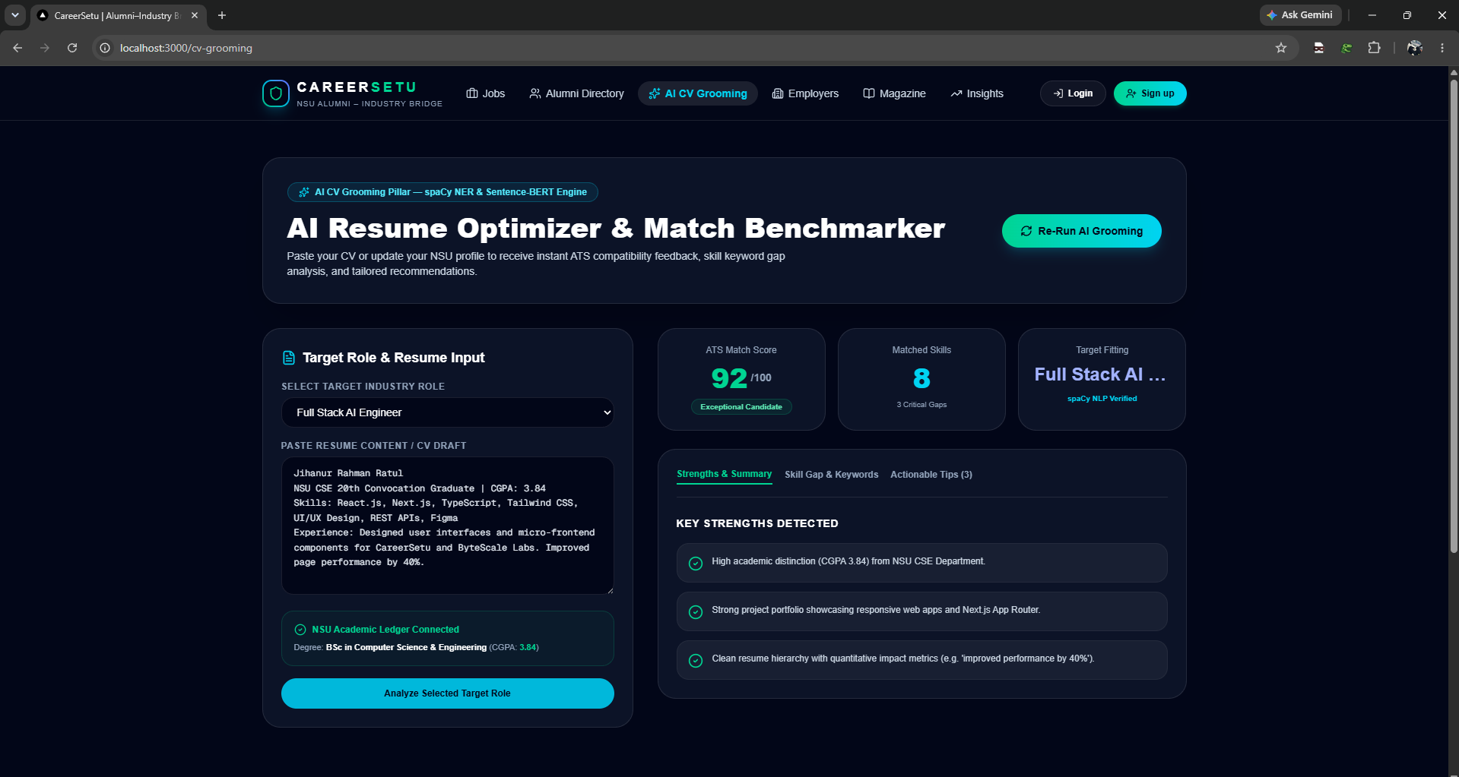
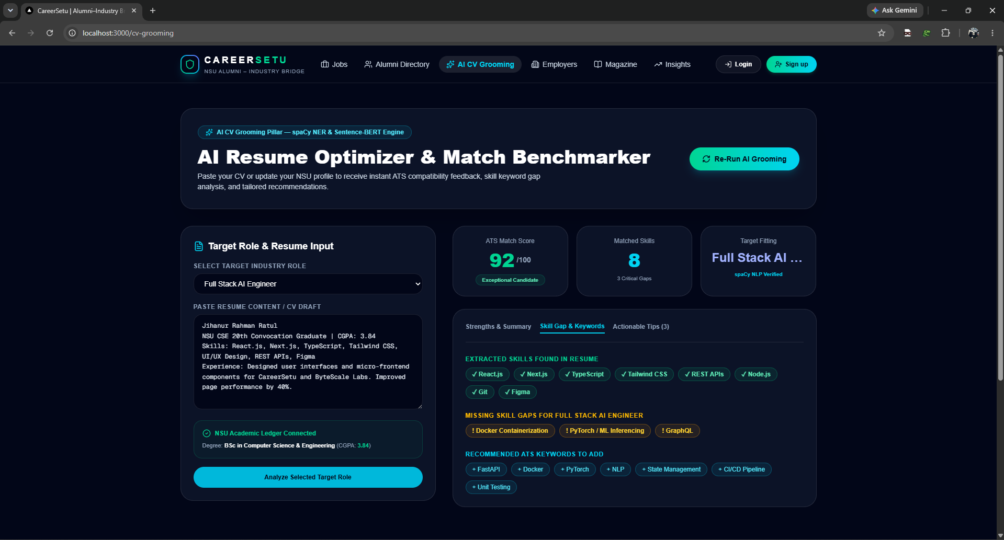
LIVE DEMO · 2 OF 4
AI CV Grooming Tool
One of the proposal’s three AI pillars, now a working tool — demoed with Jihan’s own CV: a 92/100 ATS score for "Full Stack AI Engineer," 8 matched skills, and 3 flagged gaps (Docker, PyTorch/ML inferencing, GraphQL).
AI CV Grooming — Strengths & Summary
AI CV Grooming — Skill Gap & Keywords
CareerSetu | Sprint 3 Weekly Review | CSE299 Sec.10
10 / 17

Slide 11
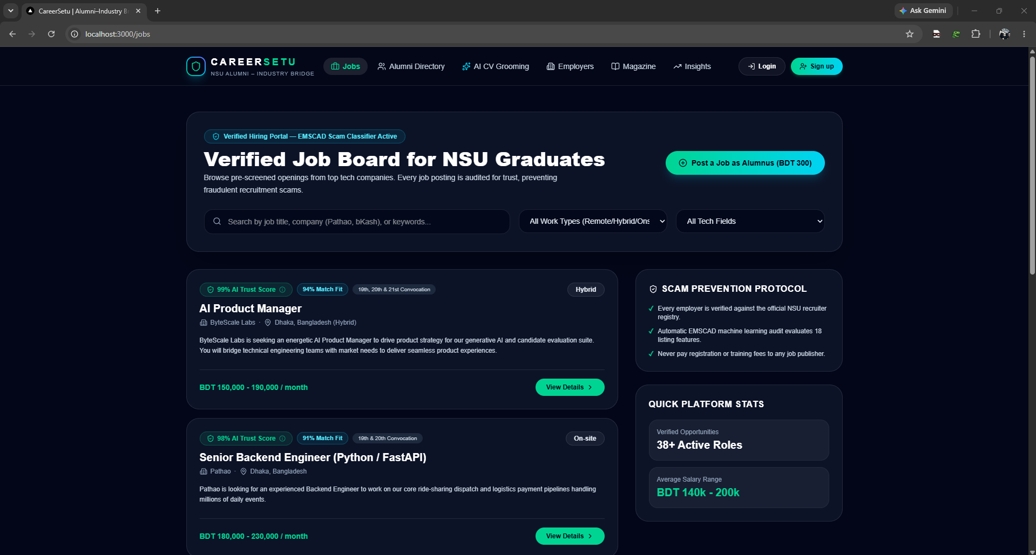
LIVE DEMO · 3 OF 4
Verified Job Board
Every listing carries an AI Trust Score (e.g. 99%) and a Match Fit % tailored to the viewer
A Scam Prevention Protocol panel explains exactly how listings get verified against NSU’s recruiter registry
"Post a Job as Alumnus (BDT 300)" is the first live piece of the monetization model
38+ active roles already seeded, spanning Pathao, ByteScale Labs and other partner firms
localhost:3000/jobs
CareerSetu | Sprint 3 Weekly Review | CSE299 Sec.10
11 / 17

Slide 12
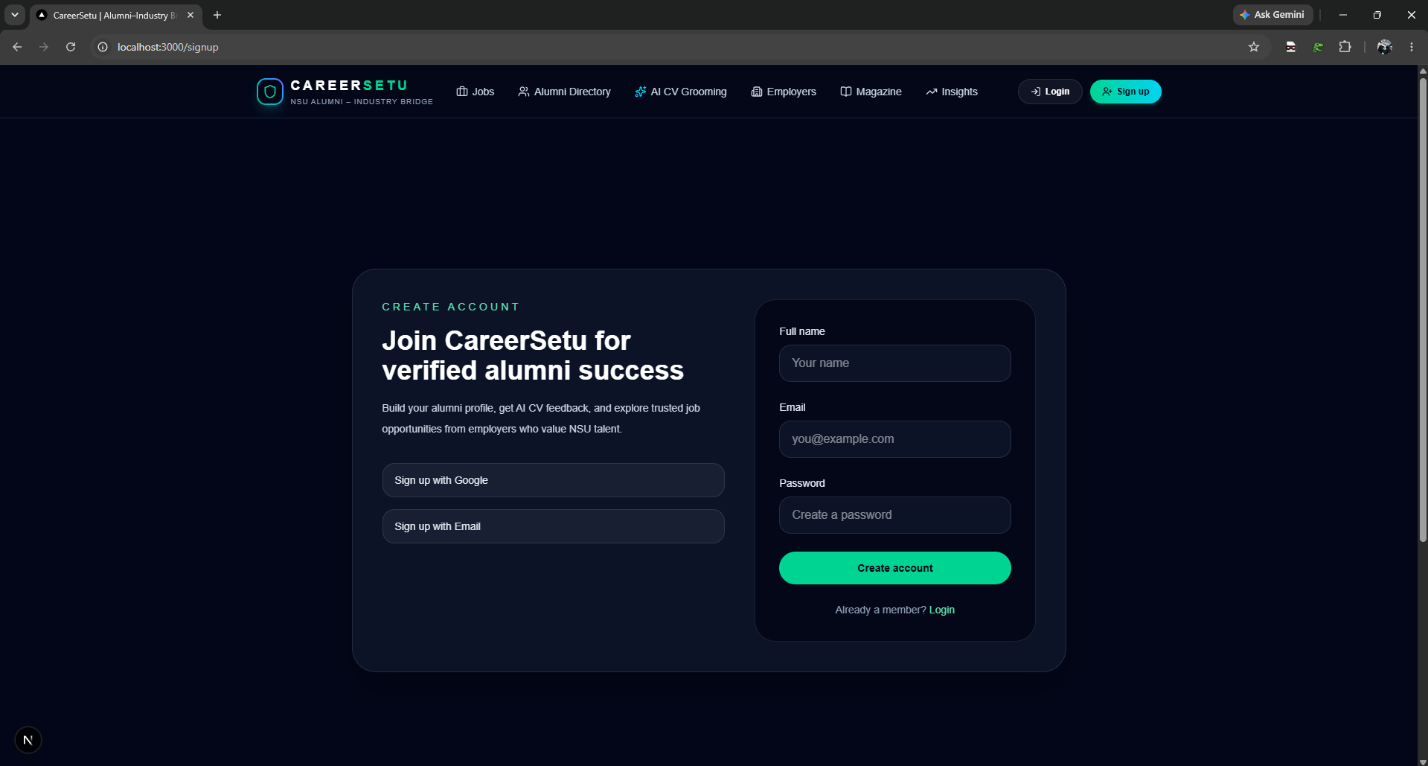
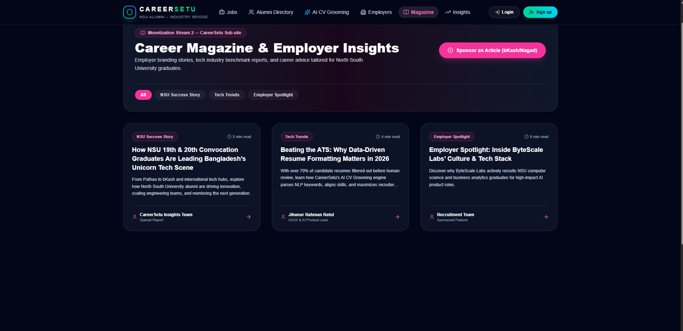
LIVE DEMO · 4 OF 4
Onboarding & Career Magazine
New alumni sign up in seconds; employers can sponsor Career Magazine features (BDT 500) — monetization stream 2, now visible in the UI.
localhost:3000/signup
localhost:3000/magazine
CareerSetu | Sprint 3 Weekly Review | CSE299 Sec.10
12 / 17

Slide 13
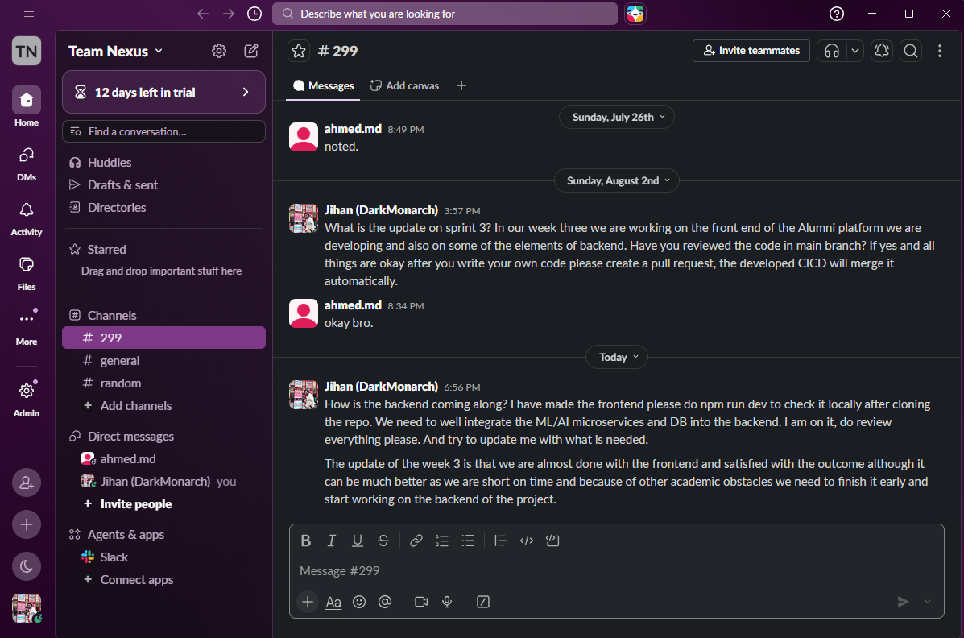
COMMUNICATION REVIEW
Team Communication — Slack
Same Team Nexus / #299 thread carries the whole sprint’s coordination history
Jul 26: Tahsin acknowledges the Sprint 2 → 3 handoff plan
Aug 2: Jihan checks progress and asks for a review + PR before merging — the CI/CD pipeline auto-merges once checks pass
Today: Jihan reports the frontend is essentially done and pivots the conversation to backend integration
Slack — Team Nexus / #299
CareerSetu | Sprint 3 Weekly Review | CSE299 Sec.10
13 / 17

Slide 14
RISK MANAGEMENT
Risks & Issues
Risk | Likelihood | Impact | Mitigation
Sprint duration doubled from the planned 1 week to 2 | Medium | Medium | Sprint 4 is scoped tighter, with daily backend check-ins to avoid a repeat
Frontend currently runs entirely on mock data, not a live backend | High | High | Sprint 4 is explicitly scoped to wire FastAPI/Node.js + PostgreSQL/Redis into every page
Academic exams have now delayed two sprints in a row | High | Medium | Sprint 4 is marked High priority; both members are syncing daily via Slack to protect the timeline
Only the lead has authored commits to the codebase so far | Medium | Medium | Sprint 4 explicitly assigns Tahsin to backend integration work, bringing a second active contributor
Two risks carried over from last week (single contributor, exam overlap) are still open — tracked, not hidden.
CareerSetu | Sprint 3 Weekly Review | CSE299 Sec.10
14 / 17

Slide 15

RETROSPECTIVE
What Went Well, What We’re Improving
WENT WELL
TO IMPROVE
All 10 planned pages shipped: Home, CV Grooming, Alumni Directory, Jobs, Employer, Magazine, Admin, Insights, Dashboard, Profile
One consistent glassmorphism design system across every single page
All 3 AI/Trust pillars from the proposal are now visible and interactive: Trust Badge, Blockchain modal, AI CV Grooming
Monetization UI is already in place: BDT 300 job posts, BDT 500 sponsored articles
Still running on mock data — real backend integration is now the critical path
Sprint slipped from 1 week to 2 — tighter scoping needed for Sprint 4
Get Tahsin actively committing code — currently 1 contributor on the repo
100%
Sprint 3 completion — a full 10-page frontend shipped and verified running on main.
CareerSetu | Sprint 3 Weekly Review | CSE299 Sec.10
15 / 17

Slide 16

LOOKING AHEAD · SPRINT 4
Next Sprint: Aug 4 – 10, 2026
SPRINT 4 OBJECTIVE
Connecting the frontend with the backend and the database.
DELIVERABLE & META
Key Deliverable: A fully functional website with AI/ML microservice integration in the backend, backed by a proper database
Contributors: Jihanur Rahman Ratul & Tahsin Ahmed Sufol
Deadline: August 10, 2026
STATUS: 30% — IN PROGRESS
Sprint 4 started a little late — midterms cramped the schedule right at the sprint boundary, per this week’s own retrospective note. Priority is now High to recover the lost days, and both members are syncing daily until the backend catches up.
Priority: High
Duration: 1 week
Tags: Database / Backend
CareerSetu | Sprint 3 Weekly Review | CSE299 Sec.10
16 / 17

Slide 17

Thank You
We welcome your feedback, ITN Sir
SCORING RUBRIC & OPEN QUESTIONS
Is the frontend at the fidelity you’d expect before backend integration begins, and does our Sprint 4 scope look right for the time remaining?
CSE299 · North South University · Section 10 · Team Nexus

